Slide 1

CLI Based Text Editor

Slide 2
ABSTRACT
This C++ console-based text editor provides diverse functionalities for text manipulation and management. These include:
Text Editor Features: Create, view, edit files.
User Management: Login and signup functionality.
Text Analysis: Spell check, synonym, and meaning search.
Content Manipulation: Replace words within files.
OOP Design: Utilizes UserManager, TextProcessor, AuthManager, FileManager classes.
Data & Interface: Loads data from external files; console-based menu.

Slide 3
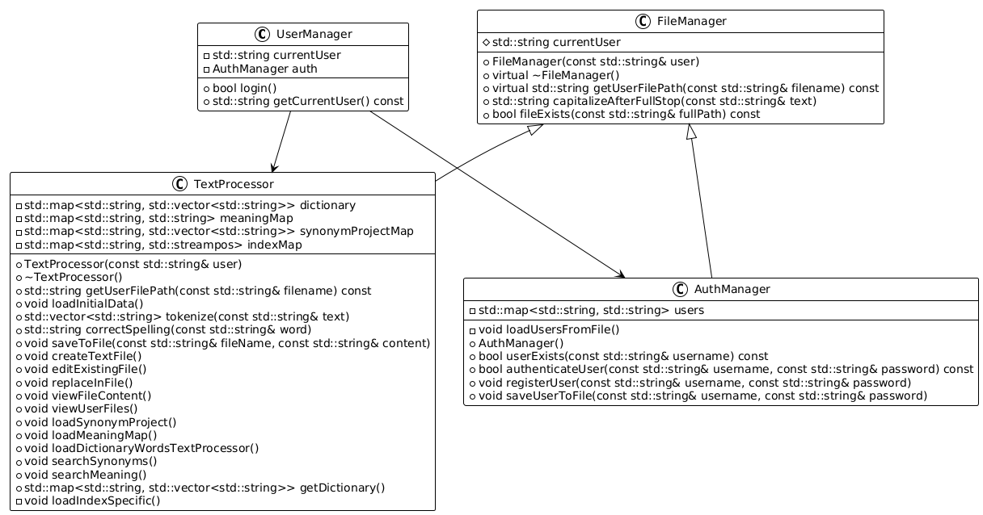
Class diagram

Slide 4
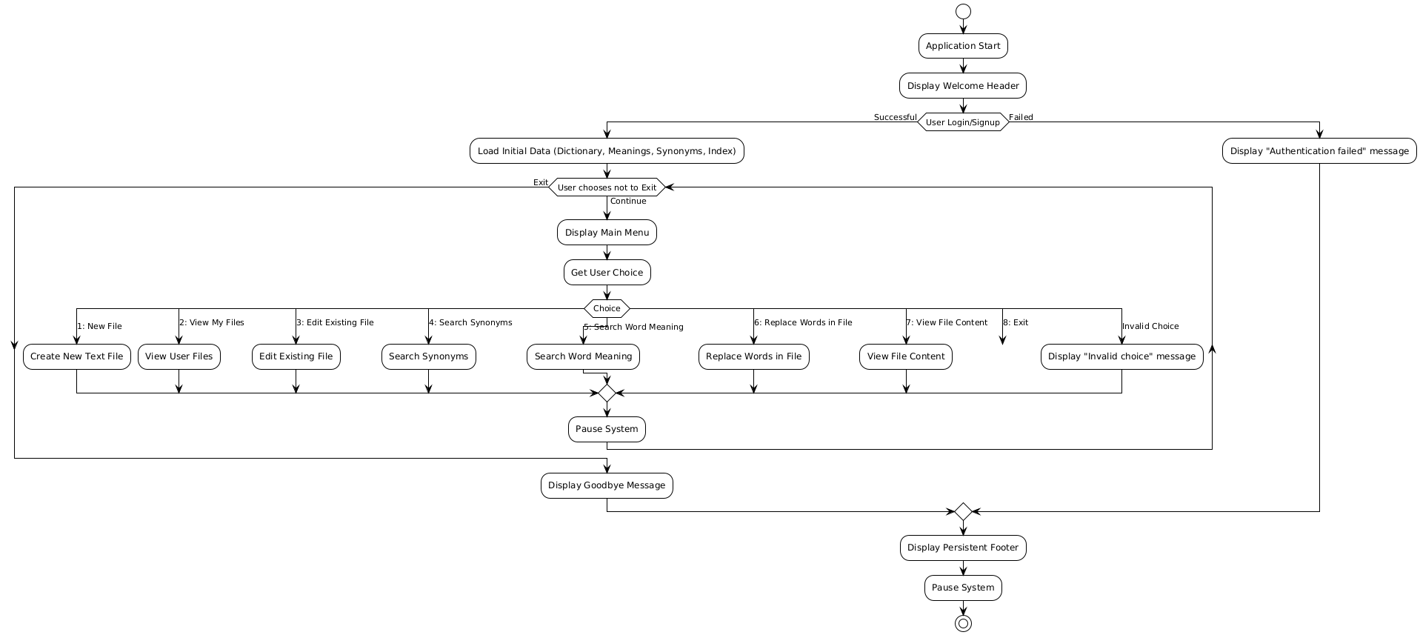
Project Flow Diagram

Slide 5
THANK YOU

